Slide 1


The Ecosystem of Android and Apps Behaviors Monitoring with Automatic Testing
Yuhao Gao

Slide 2

CONTENTS
01
02
03
04
Part One
Part Two
Part Three
Part Four
The Ecosystem of Android
Automatic Testing
Apps Behaviors Monitoring
Challenges and Future Works

Slide 3

PART ONE
The Ecosystem of Android

Slide 4



System
The Ecosystem of Android (software)
App
Google Inc.
Google
Android Devices
Android Apps

Slide 5
























System
The Ecosystem of Android (software)
App
PDK
SDK
Manufacturer
Google Inc.
App Developer
Google
Tools
ROM Developer
GMS
Google Play
App Market
Google Pixel
Rom
3rd-party Service
Android Devices
Android Apps
Analysis Tools
Analysis Methods
Datasets
LLVM
SVF
Soot
Flowdroid
Pscout
Taintdroid
Taintman
Droidbot
Frida
……
Static Analysis
Dynamic Analysis
Automatic Testing
Behaviors Monitoring
Data mining
……
AndroZoo
Koodous
VirusTotal
……

Slide 6

PART TWO
Automatic Testing

Slide 7

Why we choose automatic testing and behaviors monitoring?
Reason 1
1
It is more and more difficult to do static analysis on apps because of the protect methods such as obfuscation and shells.
Reason 2
2
Apps’ behaviors collected while they are running are more accurately than extract from code.
Reason 3
3
It is enough for some researches to using behaviors monitoring and some simple code analysis.

Slide 8

Typical Steps in an Automatic Testing circle
Step 1: Dump UI
1
Dump the current UI in a test device.
Step 2: Determine an action
2
Determine the next one action according to some strategy.
Step 3: Perform an action
3
Perform the action using some methods.
Go to Step 1

Slide 9
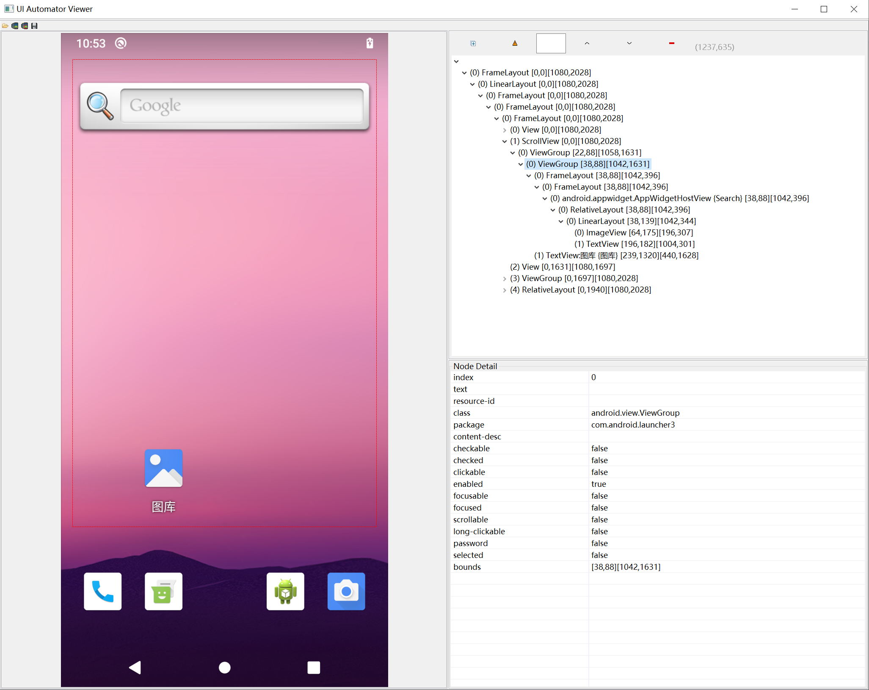
1. Dump UI

Slide 10
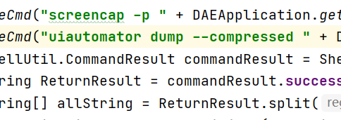
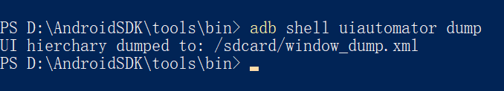
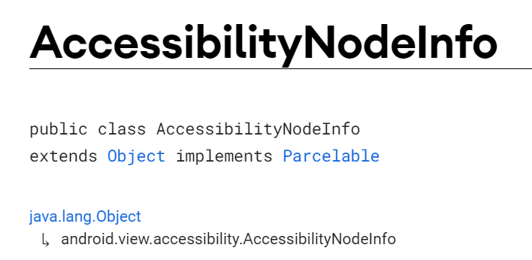
1. Dump UI
3 main method to dump Android UI.
Command to dump UI xml.
ADB to dump UI.
Call uiautomator in command line, need root privilege.
Call uiautomator in ADB shell, only can use in server with USB debug enable.
Accessibility Service to dump UI.
Lack of reliability.

Slide 11
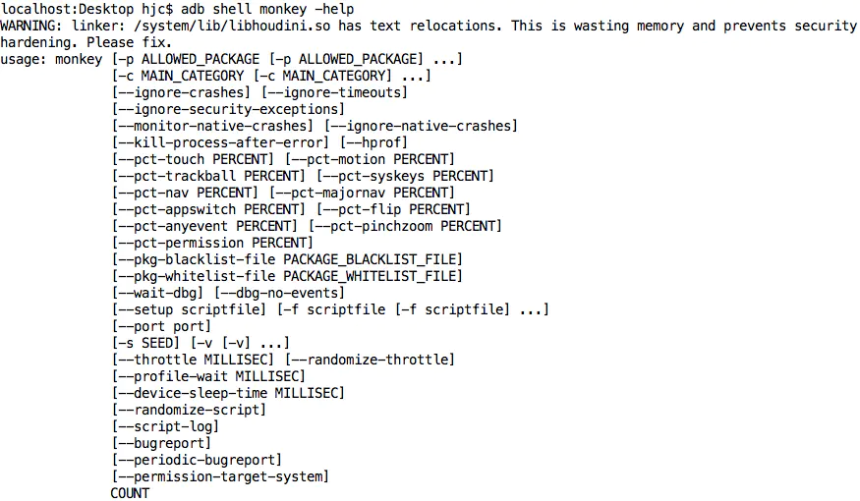
2. Determine an action
Random actions: monkey

Slide 12
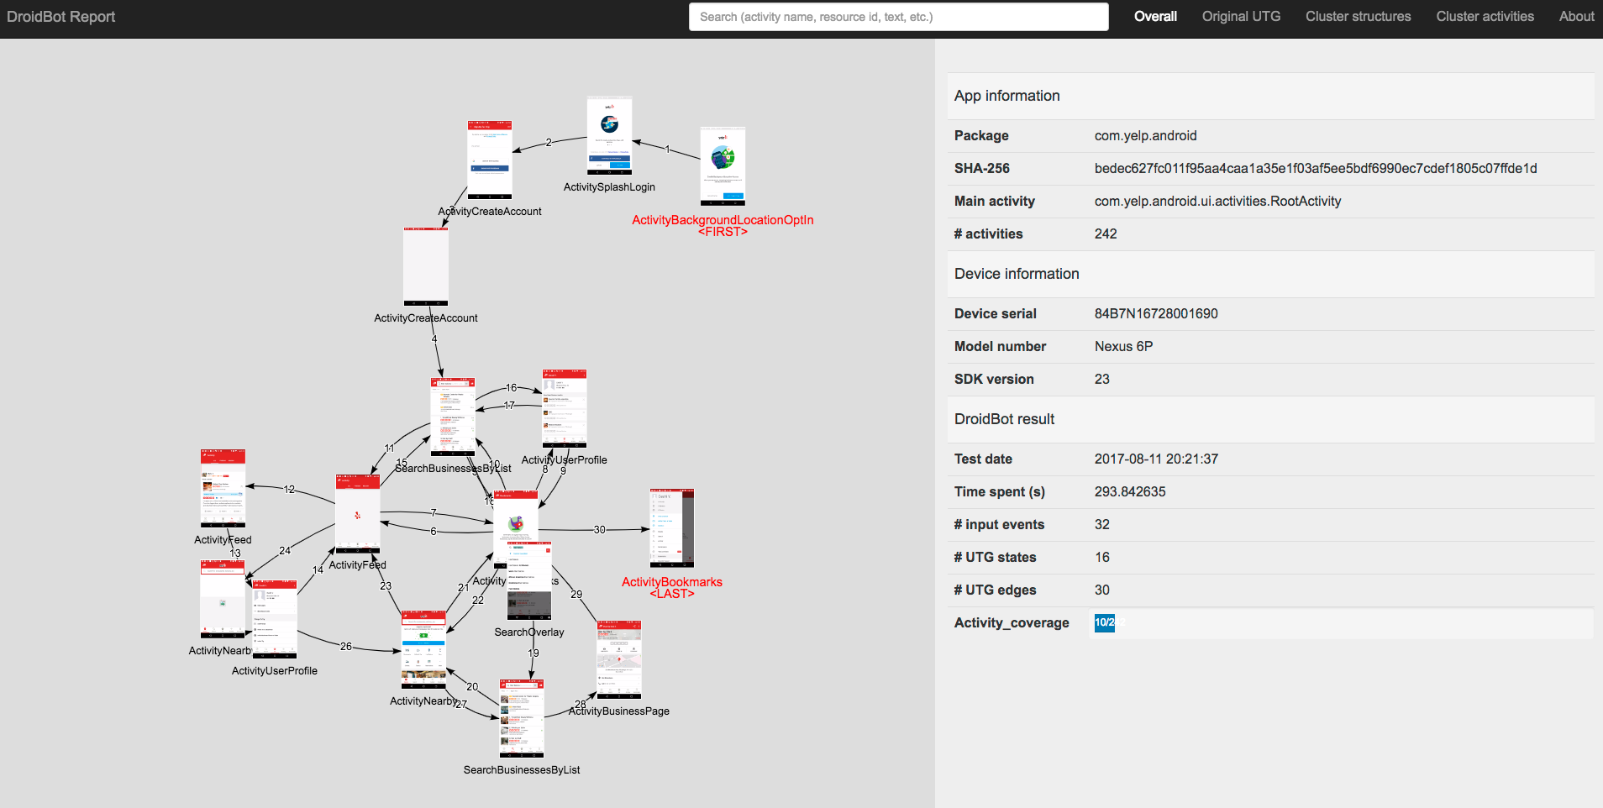
2. Determine an action
Droidbot: by strategy

Slide 13
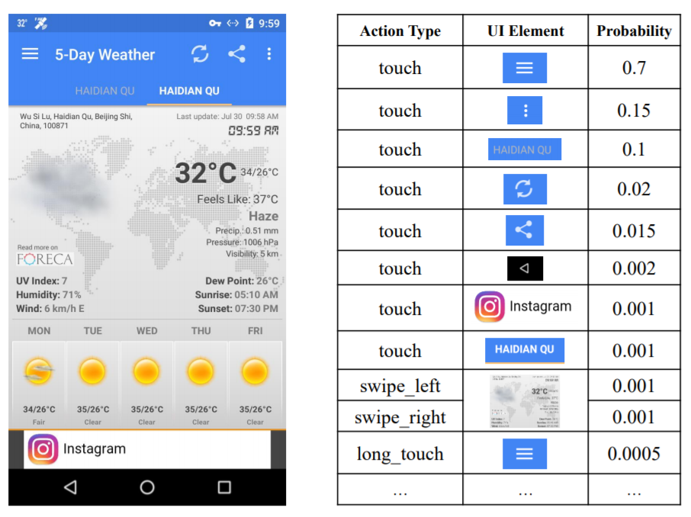
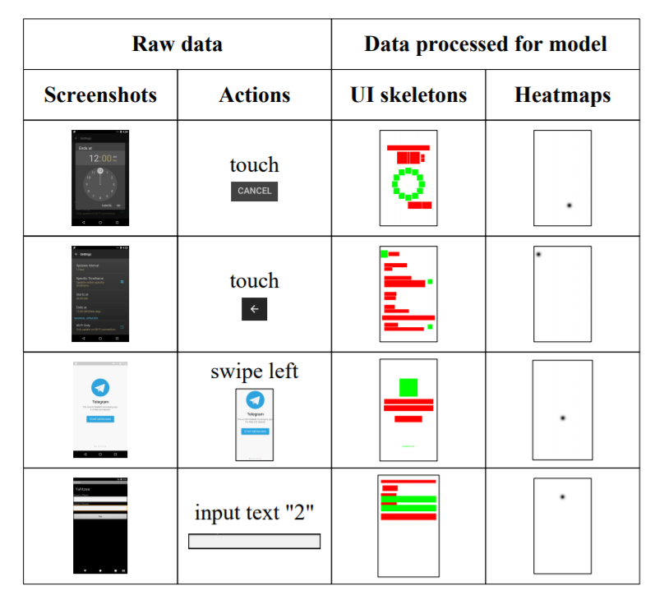
2. Determine an action
Humanoid: by DL, learned from users’ actions

Slide 14
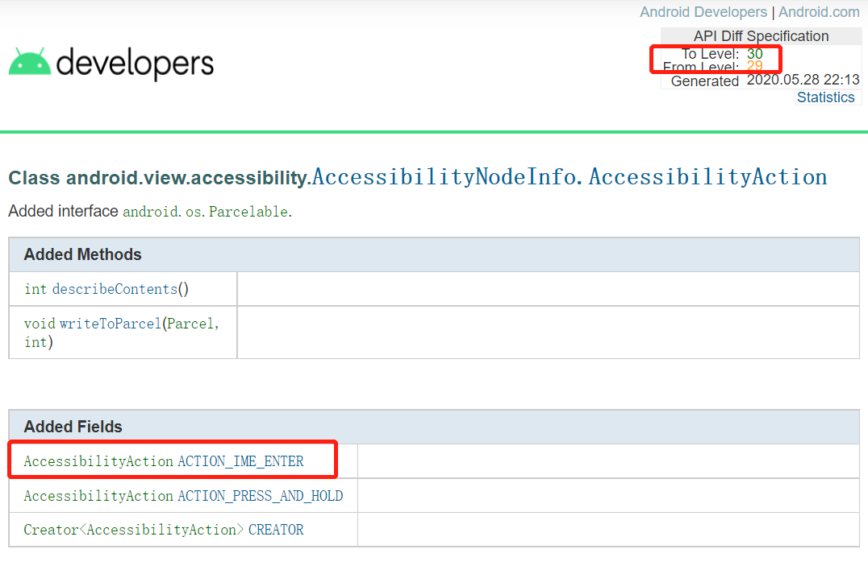
3. Perform an action
Command Line
ADB
Accessibility Service

Slide 15

PART THREE
Apps Behaviors Monitoring

Slide 16
What do we monitor?
API calls
All Android functions used by apps through API calls. We need to record the API calls’ information we interested in, including the caller, the callee and the params. The types of API we usually chosed contains the file API, network API, sensors API, device information API and some encrypt APIs.
Network traffic
Network traffic is another essential data we need to record. Beside by monitoring network APIs, we also capture network traffic by other ways, such as MITM proxy, which could help us to see the data in https protocol.

Slide 17
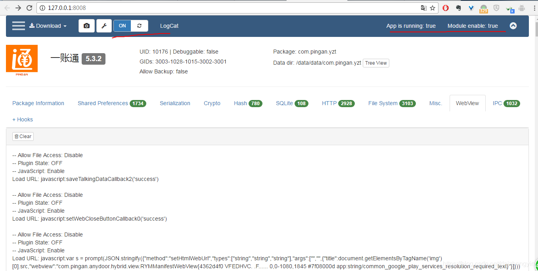
Hook: Xposed -> Edxposed -> LSPosed
Compatibility!
Inspeckage : a really old Xposed module to monitoring apps behaviors by hook APIs

Slide 18
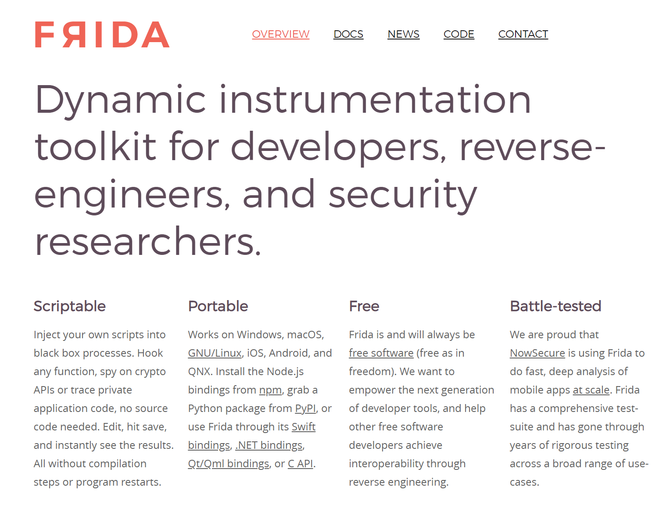
Hook: Frida

Slide 19
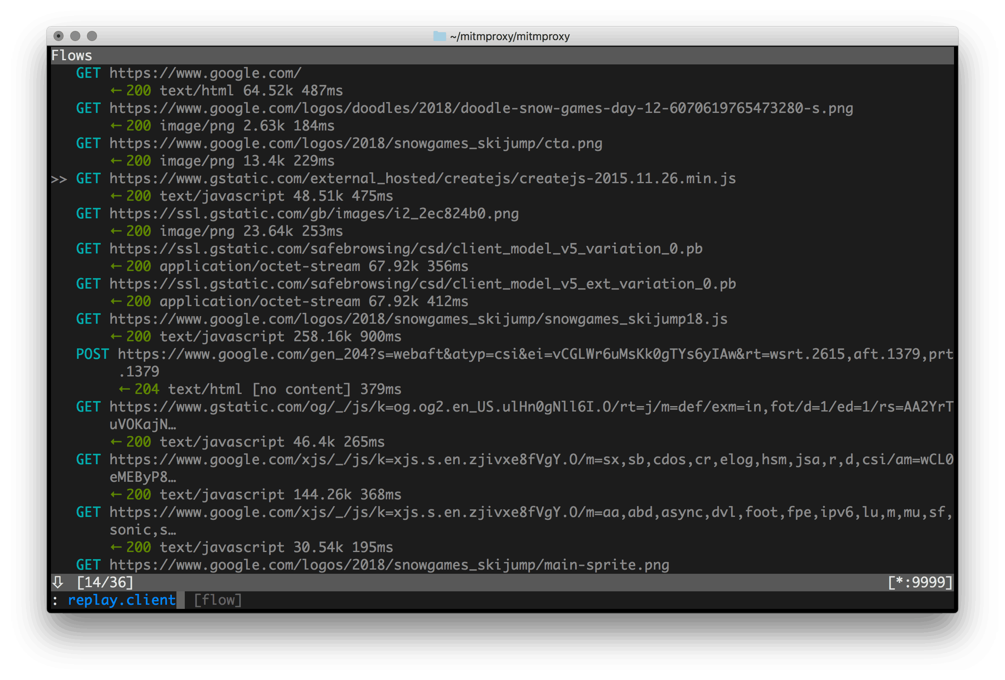
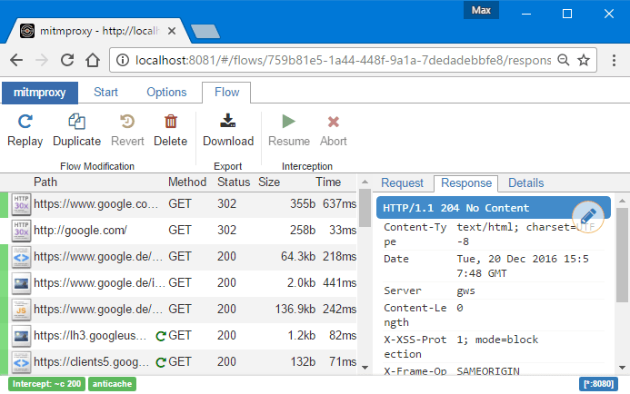
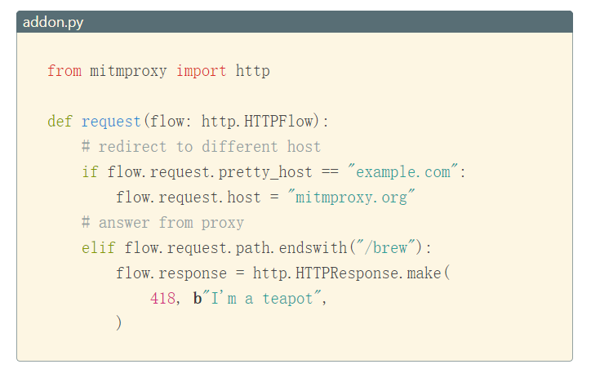
Network monitoring: mitmproxy
Command Line
Web interface
Modify messages, redirect traffic
*Use xposed module justtrustme or firda script to bypass the SSL pinning

Slide 20

PART FOUR
Challenges and Future Works

Slide 21
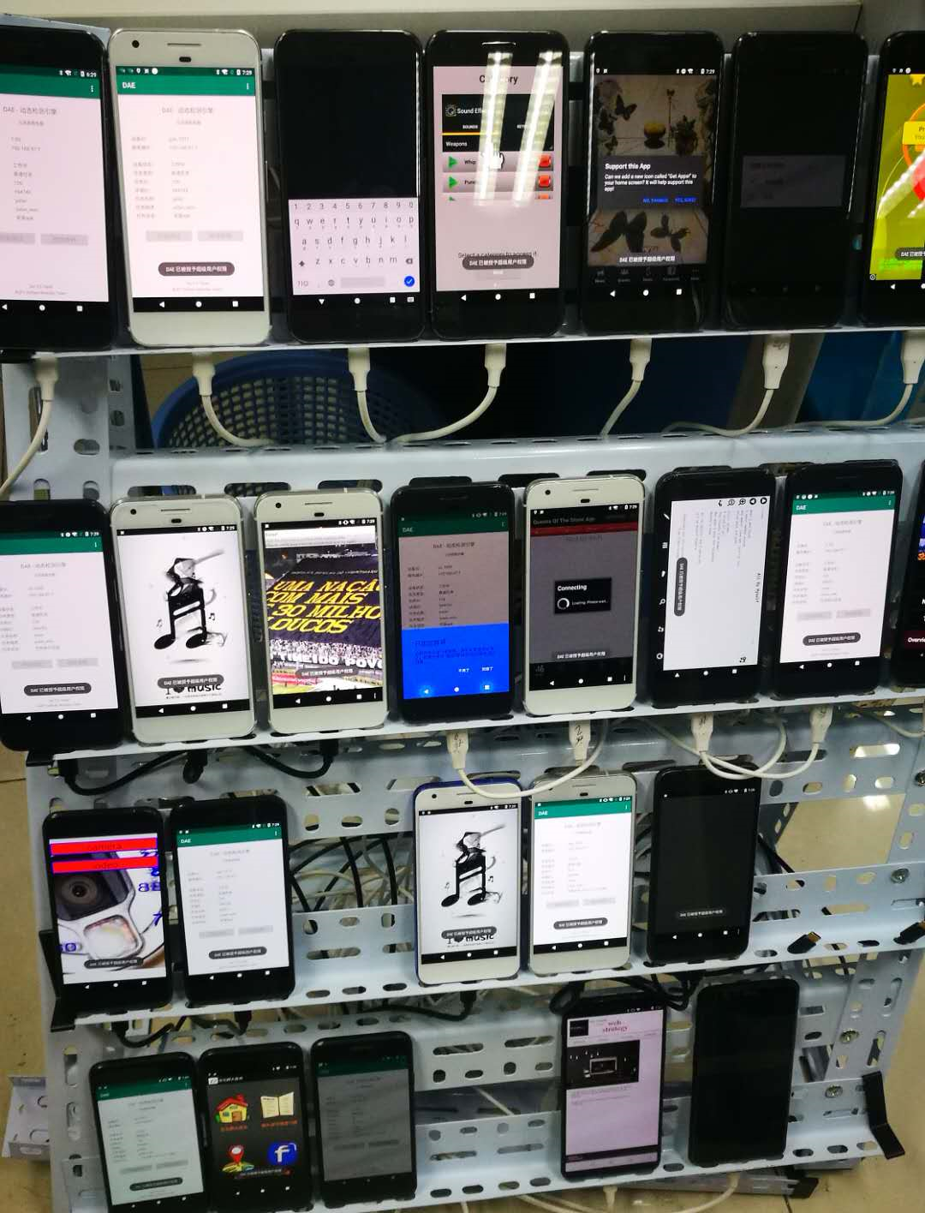
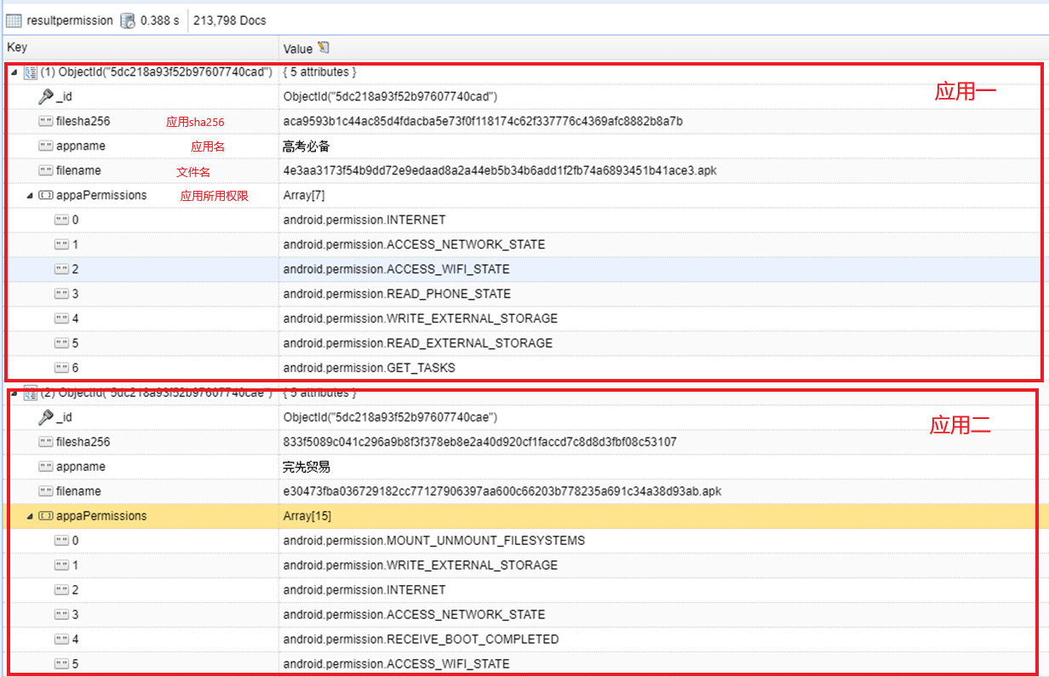
Previous works: automatic test

Slide 22
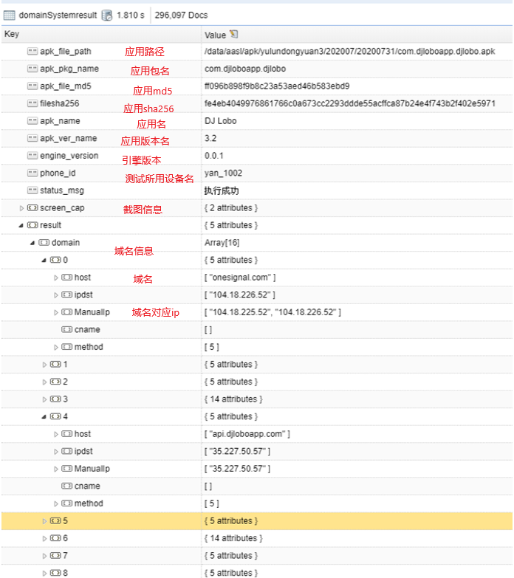
 | Main Domain
 | 3rd-party domain
Previous works: network domain
App | Version | Domain | Pkg
国家税务总局 | 1.2.8 | fxsjcj.kaipuyun.cn | com.uknower.satapp
国家税务总局 | 1.2.8 | app.chinatax.gov.cn | com.uknower.satapp
苏教版二年级语文上册 | 2.3 | www.study91.com | com.study91.sj_yuwen_2a
时代记忆 | 6.0.0 | mall.shidaijiyi.com | com.hownoon.main
美发人 | 2.32.150716 | s.p.qq.com | com.cutt.zhiyue.android.app720210
美发人 | 2.32.150716 | qn.cutt.com | com.cutt.zhiyue.android.app720210
美发人 | 2.32.150716 | qn.zhiyueapp.cn | com.cutt.zhiyue.android.app720210
美发人 | 2.32.150716 | zhiyue.cutt.com | com.cutt.zhiyue.android.app720210
美发人 | 2.32.150716 | api.zhiyueapp.cn | com.cutt.zhiyue.android.app720210
美发人 | 2.32.150716 | pkg.appresource.net | com.cutt.zhiyue.android.app720210
准格尔旅游 | 1.02 | dypack.sinotl.com | com.sino.app.advancedA57254
准格尔旅游 | 1.02 | mh.sinotl.com | com.sino.app.advancedA57254
准格尔旅游 | 1.02 | app.sinotl.com | com.sino.app.advancedA57254
龙岩畅想社区 | 1.01.01 | app.kuaizhan.com | com.sohu.kuaizhan.z8825851730
龙岩畅想社区 | 1.01.01 | pic.kuaizhan.com | com.sohu.kuaizhan.z8825851730
龙岩畅想社区 | 1.01.01 | www.kuaizhan.com | com.sohu.kuaizhan.z8825851730
龙岩畅想社区 | 1.01.01 | s8825851730.kuaizhan.com | com.sohu.kuaizhan.z8825851730
龙岩畅想社区 | 1.01.01 | pfile.kuaizhan.com | com.sohu.kuaizhan.z8825851730
龙岩畅想社区 | 1.01.01 | zz.bdstatic.com | com.sohu.kuaizhan.z8825851730
龙岩畅想社区 | 1.01.01 | pv.kuaizhan.com | com.sohu.kuaizhan.z8825851730
龙岩畅想社区 | 1.01.01 | sp0.baidu.com | com.sohu.kuaizhan.z8825851730
呼呼 | 5.4.3 | api.imhuhu.com | com.xunai.sleep

Slide 23
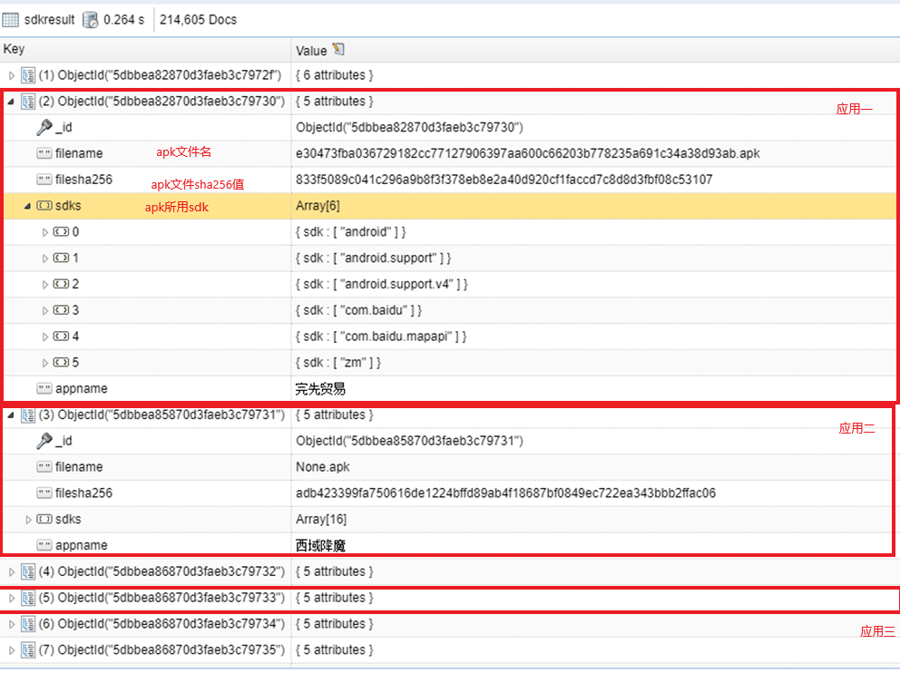
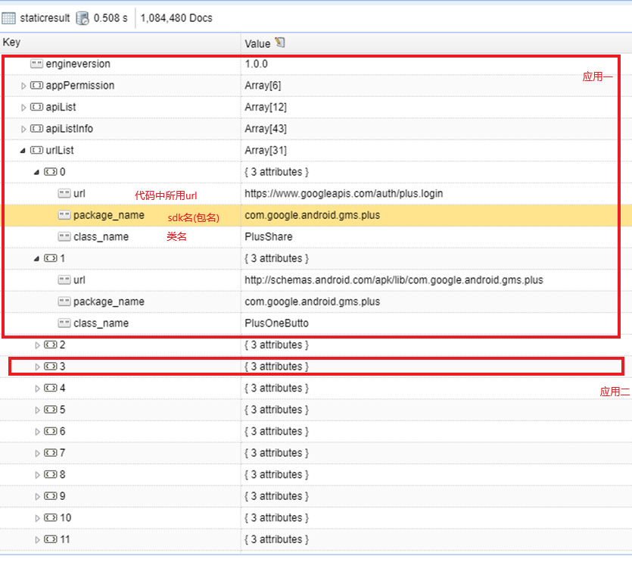
Previous works: 3rd-party libs

Slide 24
Challenges
New malware types
01
Ad fraud, illegal apps and privacy leaks… It is difficult for traditional anti-virus engine to detect.
New protections
02
VMP shells and anti-analysis techs are improved rapidly.
New 3rd-party services
03
Private distribution channels, CDNs, payment platforms, which only serve for malwares are difficult to track.

Slide 25
Future Works
More smart automatic testing strategy.
More effective behavior monitoring techs. (Hook from system)
Static and dynamic analysis techs.

Slide 26
THANKS
2021.8.20

